Slide 1
PHP Web Forms and Form Validation
ITWA133

Slide 2
PHP Predefined Functions
Objectives
To apply the available super global variables for form processing and validation.
To differentiate the use of $_GET, $_POST, and $_REQUEST super global variable in form processing and know when to use it.
To differentiate the use of Session and Cookies for form security of a Web Site.
To know the proper syntax for validating user inputs using Regular Expression.

Slide 3
Superglobal variables
$_SERVER
is an array containing information such as headers, paths, and script locations.
entries were created by the web server
Index ‘PHP_SELF’ contains the filename of the currently executing script.
$_GET
an associative array variables passed to the current script via the URL parameters.
$_POST
an associative array of variables passed to the current script via the HTTP POST method.

Slide 4
Superglobal variables
$_REQUEST
an associative array that by default contains the contents of $_GET, $_POST, and $_COOKIE
$_COOKIE
an associative array of variables passed to the current script via HTTP Cookies
$_SESSION
an associative array containing session variables available to the script
$_ENV
an associative array of variables passed to the current script via the environment method

Slide 5
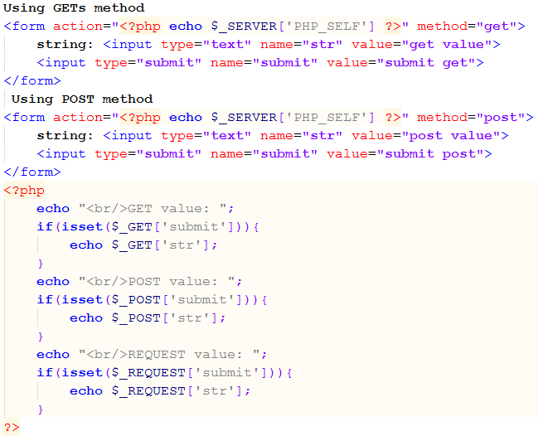
Superglobal variables
Example:

Slide 6
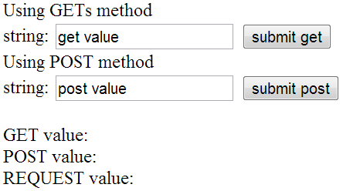
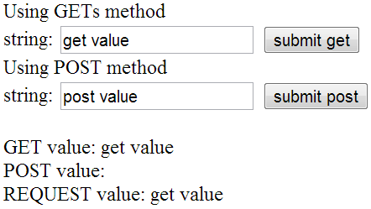
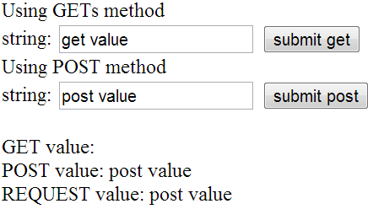
Superglobal variables
Output: before button was clicked
Output: submit get button was clicked
Output: submit post button was clicked

Slide 7
Cookies
are mechanism for storing data in the remote browser and thus tracking or identifying return users.
small amount of information containing variable=value pair (user’s computer).
users can refuse to accepts cookies.
Managing cookies can be done using setcookie() function
syntax: setcookie()
bool setcookie ( string $name [, string $value [, int $expire = 0 [, string $path [, string $domain [, bool $secure = false [, bool $httponly = false ]]]]]] )

Slide 8
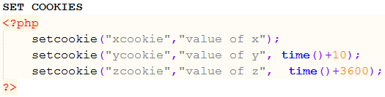
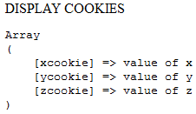

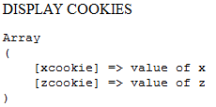


Cookies
Example: PHPSetCookies.php
Output 1: cookies were set
Example: PHPDisplayCookies.php
Output 2: after 10 secs
Example: PHPDeleteCookies.php
Output 3: delete cookies

Slide 9
Session
are mechanism for storing data on the server itself.
is the time that a user spends at your Web site.
more secure than cookies and can store much more information
to open a session use session_start() function
always set at the beginning of each Web page.
to close the session use session_destroy() function
gets rid of all the session variable information that’s stored in the session file.
the statement does not affect the variables set on the current page.

Slide 10
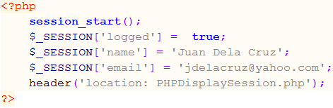
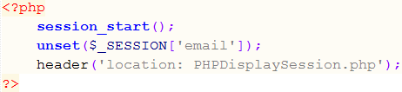
Session
to unset session variables use unset() function
syntax
unset($_SESSION[‘varname’]);
Example: PHPSetSession.php
Example: PHPUnsetSession.php

Slide 11
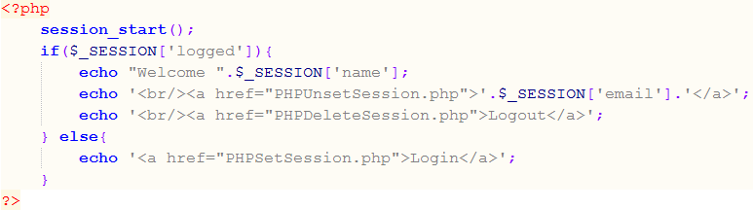
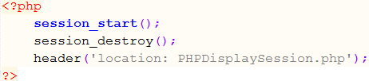
Session
Example: PHPDisplaySession.php
Example: PHPDeleteSession.php

Slide 12
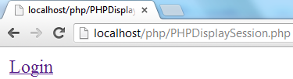
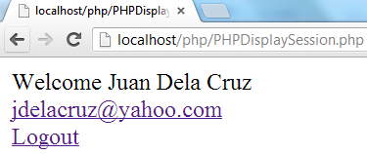
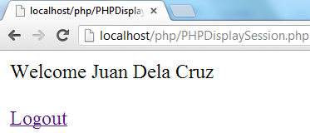
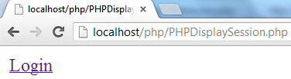
Session
Output: user load PHPDisplaySession.php page
Output: user clicked the Login link
Output: user clicked the email link
Output: user clicked the logout link

Slide 13
Regular Expression
were used to efficiently search for patterns in a given text.
also known as regex or regexp.
PHP implements Percl Compatible Regular Expression (PCRE)
PCRE function starts with preg_
preg_match() function
Performs a regular expression match
Syntax: int preg_match ( string $pattern , string $subject [, array &$matches [, int $flags = 0 [, int $offset = 0 ]]] )

Slide 14
Regular Expression
Regex Meta Characters
Symbol | Description
^ | Marks the start of a string
$ | Marks the end of a string
. | Matches any single character
| | Boolean OR
() | Group elements
[abc] | Item range (a,b or c)
[^abc] | Not in range (every character except a,b, or c)
\s | white-space character
a? | Zero or one ‘a’ character. Equals to a{0,1}
a* | Zero or more of ‘a’

Slide 15
Regular Expression
Regex Meta Characters (continue)
Symbol | Description
a+ | One or more of ‘a’
a{2} | Exactly two of ‘a’
a{,5} | Up to five of ‘a’
a{5,10} | Between five to ten of ‘a’
\w | Any alpha numeric character plus underscore. Equals to [A-Za-z0-9_]
\W | Any non alpha numeric characters
\s | Any white-space character
\S | Any non white-space character
\d | Any digits. Equal to [0-9]
\D | Any non-digits. Equal to [^0-9]

Slide 16
Regular Expression
Regex Pattern Modifiers
 | Description
i | Ignore Case
m | Multiline Mode
S | Extra analysis of pattern
u | Pattern is treated as UTF-8

Slide 17
Regular Expression
Example
Example | Description
‘/hello/’ | It will match the word hello
‘/^hello/’ | It will match hello at the start of a string. Possible matches are hello orhelloworld, but not worldhello
‘/hello$/’ | It will match hello at the end of a string.
‘/he.o/’ | It will match any character between he and o. Possible matches are heloor heyo, but not hello
‘/he?llo/’ | It will match either llo or hello
‘/hello+/’ | It will match hello on or more time. E.g. hello or hellohello
‘/he*llo/’ | Matches llo, hello or hehello, but not hellooo
‘/hello|world/’ | It will either match the word hello or world
‘/(A-Z)/’ | Using it with the hyphen character, this pattern will match every uppercase character from A to Z. E.g. A, B, C…

Slide 18
Regular Expression
Example: (continue)
Example | Description
‘/[abc]/’ | It will match any single character a, b or c
‘/abc{1}/’ | Matches precisely one c character after the characters ab. E.g. matchesabc, but not abcc
‘/abc{1,}/’ | Matches one or more c character after the characters ab. E.g. matches abcor abcc
‘/abc{2,4}/’ | Matches between two and four c character after the characters ab. E.g. matches abcc, abccc or abcccc, but not abc

Slide 19
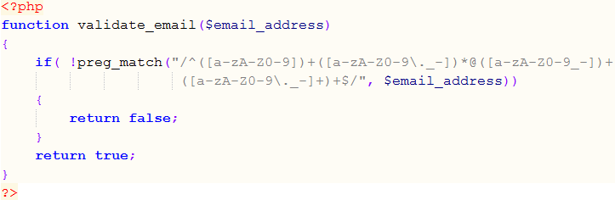
Regular Expression
Useful Regex Functions
Email validation

